Slide 1
Loan Prediction

Slide 2
OVERVIEW
Introduction
Problem Statement
Research Questions
Related Studies
Dataset
Methodology
Experimental Setup
Results
Project Timeline
Professional, legal, social and ethical issues
Conclusions

Slide 3
INTRODUCTION
Recent advances in cheap and efficient computing power gave rise implementation of state-of-the-art machine learning models which earlier wasn’t possible.
Earlier Lending loan models were based on painstaking process of creation of statistical models by quant analysts
Now these statistical models are replaced with much more advanced and targeted predictive models which reflect real time accurate lending polices

Slide 4
Problem statement
How can deep learning models be effectively utilized to predict loan affordability rates using HMDA housing data, and how can this information be leveraged to create most affordable housing loan terms for borrowers?

Slide 5
CHALLENGES
Regulatory and Compliance Issues – Fair Lending Practices: Ensuring that the model's predictions do not inadvertently lead to discriminatory lending practices. Compliance with laws such as the Equal Credit Opportunity Act (ECOA) and Fair Housing Act is crucial.
Transparency and Accountability: Regulatory bodies may require detailed explanations of how loan terms are determined, necessitating interpretable mode.
Dynamic Economic Conditions:
Market Fluctuations: Economic conditions such as interest rates, employment rates, and housing market trends can change rapidly, affecting loan affordability.
Policy Changes: Government policies regarding housing loans and subsidies can alter the landscape, requiring the model to be adaptable.

Slide 6
CHALLENGES
Borrower-Specific Factors:
Creditworthiness Variability: Borrowers' financial situations can change, affecting their creditworthiness and thus their loan affordability.
Personal Circumstances: Factors such as health, employment stability, and unexpected expenses can impact a borrower's ability to afford a loan.
Data Privacy and Security:
Sensitive Information: Handling sensitive borrower information requires robust data privacy and security measures to prevent breaches and misuse.
Data Sharing: Collaborating with financial institutions for data sharing needs to be done securely and ethically.

Slide 7
Research question
"How can deep learning models be developed and implemented to predict loan affordability rates using HMDA housing data, while ensuring regulatory compliance, fairness, and adaptability to dynamic economic conditions, to create the most affordable and accessible housing loan terms for borrowers?"
Model Development and Accuracy:
What deep learning architectures are most effective in predicting loan affordability rates using HMDA data?
How can feature engineering and selection be optimized to improve model performance?

Slide 8
Related studies and research gaps
References | Existing studies
S, S.M., & Kumar, K.K. (2023). Prediction of Loan Pricing on the basis of Area Location using K-Nearest Neighbour and Support Vector Machine Learning Algorithms. 2023 International Conference on Sustainable Communication Networks and Application (ICSCNA), 1036-1041. | Estimating the Loan amount settlement depends on the area of location and issuance of Loan for the customer of the bank is the risk-taking process. This research aims to employ a novel K-Nearest Neighbour (KNN) approach, in contrast to the Support Vector Machine (SVM) algorithm, for estimating loan prices based on geographical factors.
Diwate, Y., Rana, P.S., & Chavan, P.A. (2023). LOAN APPROVAL PREDICTION USING MACHINE LEARNING. International Research Journal of Modernization in Engineering Technology and Science. | The proposed approach involves collecting and pre-processing a large dataset containing historical loan applications, including various financial and personal attributes, which is fed into a machine learning model that predicts the likelihood of loan approval based on the input features.

Slide 9
Related studies and research gaps
References | Existing studies
S, S.M., & Kumar, K.K. (2023). Prediction of Loan Pricing on the basis of Area Location using K-Nearest Neighbour and Support Vector Machine Learning Algorithms. 2023 International Conference on Sustainable Communication Networks and Application (ICSCNA), 1036-1041. | Estimating the Loan amount settlement depends on the area of location and issuance of Loan for the customer of the bank is the risk-taking process. This research aims to employ a novel K-Nearest Neighbour (KNN) approach, in contrast to the Support Vector Machine (SVM) algorithm, for estimating loan prices based on geographical factors.
Diwate, Y., Rana, P.S., & Chavan, P.A. (2023). LOAN APPROVAL PREDICTION USING MACHINE LEARNING. International Research Journal of Modernization in Engineering Technology and Science. | The proposed approach involves collecting and pre-processing a large dataset containing historical loan applications, including various financial and personal attributes, which is fed into a machine learning model that predicts the likelihood of loan approval based on the input features.

Slide 10
research gaps
No Explainable AI Models
No Biases/ Normalization Techniques Applied
No Real time feedback on models deployed in production
Exceptional Cases

Slide 11
DATASET

Slide 12
DATASET

Slide 13
DATASET

Slide 14
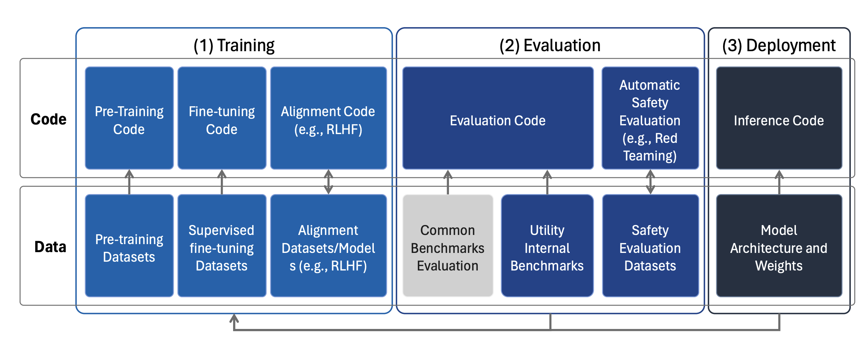
methodology

Slide 15
PROJECT TIMELINE
Time Line | Duration
Ethics Approval | 1 week
Literature Review | 2 weeks
Data Collection | 1 week
Data Preprocessing and Feature engineering and selection | 1 week
Model Development | 3 weeks
Testing and Validation | 2 weeks
Conclusion and Reporting | 1 week

Slide 16
Professional , legal, social and ethical issues

Slide 17
Conclusions

Slide 18
references
Leying, Zou., Warut, Khern-am-nuai. (2022). AI and housing discrimination: the case of mortgage applications. AI and ethics, doi: 10.1007/s43681-022-00234-9
Avery, Robert & Bhutta, Neil & Brevoort, Kenneth & Canner, Glenn. (2011). The Mortgage Market in 2010: Highlights from the Data Reported under the Home Mortgage Disclosure Act. Federal Reserve Bulletin. 97. 10.17016/bulletin.2011.97-6.

Slide 19
Thank you

Slide 20
Overcoming nervousness
Confidence-building strategies

Slide 21
Effective delivery techniques
This is a powerful tool in public speaking. It involves varying pitch, tone, and volume to convey emotion, emphasize points, and maintain interest:
Pitch variation
Tone inflection
Volume control
Effective body language enhances your message, making it more impactful and memorable:
Meaningful eye contact
Purposeful gestures
Maintain good posture
Control your expressions

Slide 22
Navigating Q&A sessions
Know your material in advance
Anticipate common questions
Rehearse your responses
Maintaining composure during the Q&A session is essential for projecting confidence and authority. Consider the following tips for staying composed:
Stay calm
Actively listen
Pause and reflect
Maintain eye contact

Slide 23
Dynamic delivery
Learn to infuse energy into your delivery to leave a lasting impression
One of the goals of effective communication is to motivate your audience
Metric | Measurement | Target | Actual
Audience attendance | # of attendees | 150 | 120
Engagement duration | Minutes | 60 | 75
Q&A interaction | # of questions | 10 | 15
Positive feedback | Percentage (%) | 90 | 95
Rate of information retention | Percentage (%) | 80 | 85

Slide 24
Final tips & takeaways
Consistent rehearsal
Strengthen your familiarity
Refine delivery style
Pacing, tone, and emphasis
Timing and transitions
Aim for seamless, professional delivery
Practice audience
Enlist colleagues to listen & provide feedback
Seek feedback
Reflect on performance
Explore new techniques
Set personal goals
Iterate and adapt

Slide 25
Navigating Q&A sessions
Impact factor | Measurement | Target | Achieved
Audience interaction | Percentage (%) | 85 | 88
Knowledge retention | Percentage (%) | 75 | 80
Post-presentation surveys | Average rating | 4.2 | 4.5
Referral rate | Percentage (%) | 10 | 12
Collaboration opportunities | # of opportunities | 8 | 10

Slide 26
Thank you
Brita Tamm
502-555-0152
brita@firstupconsultants.com
www.firstupconsultants.com

